Slide 1
Extraordinary Threats Require Extraordinary Actions
Murat Egrikavuk, Ali Yamac
Obruk Caving Group/ TURKEY

Slide 2
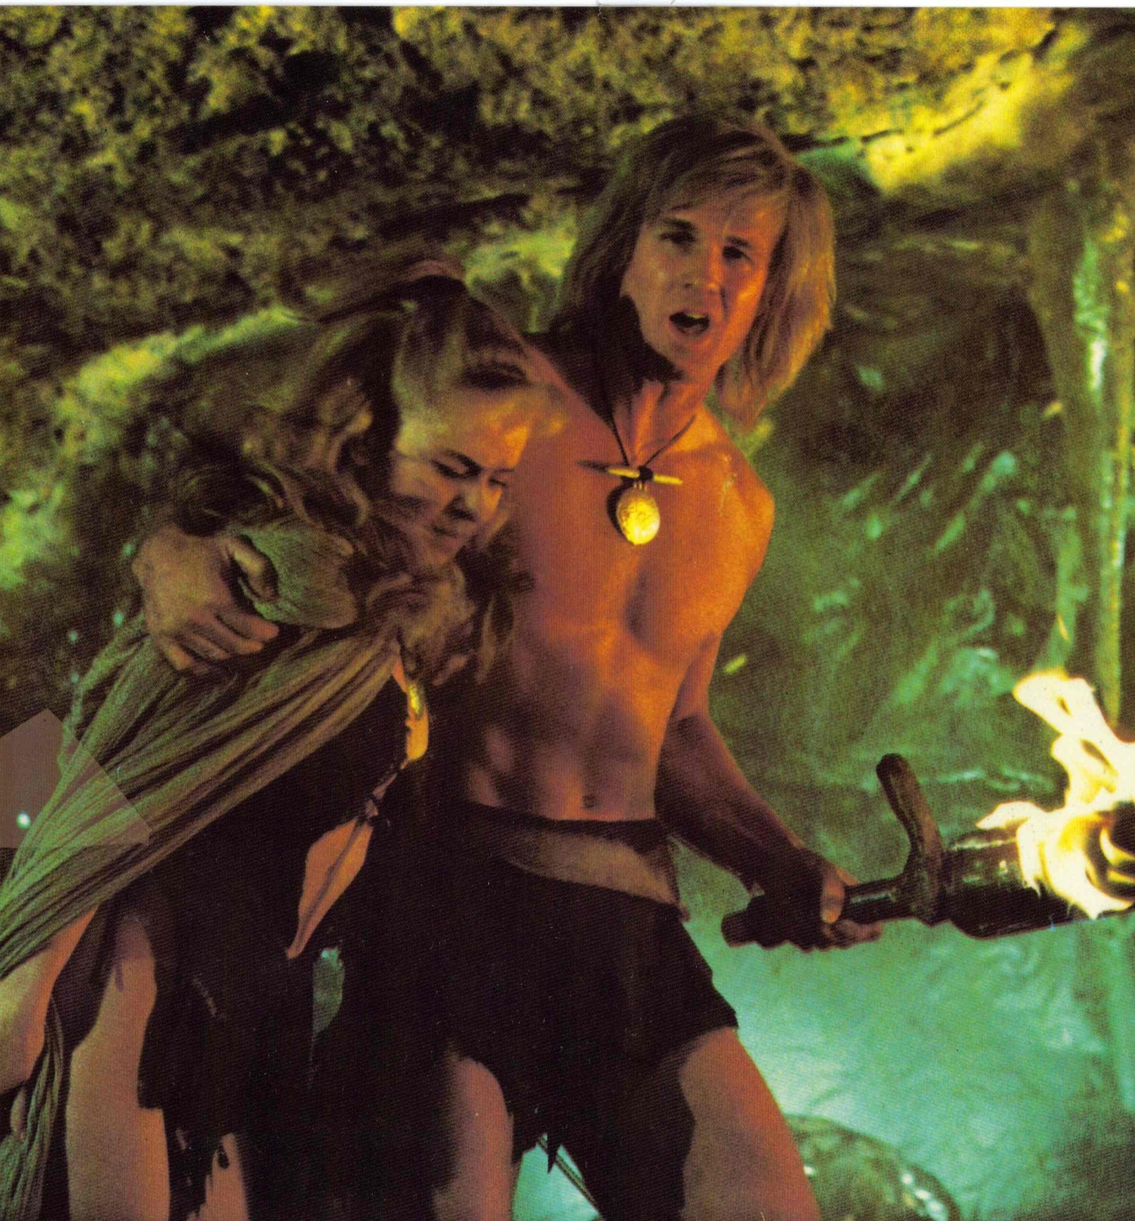
Notes:
So let's start with this guy: Yor, the Hunter from the Future!

Slide 3
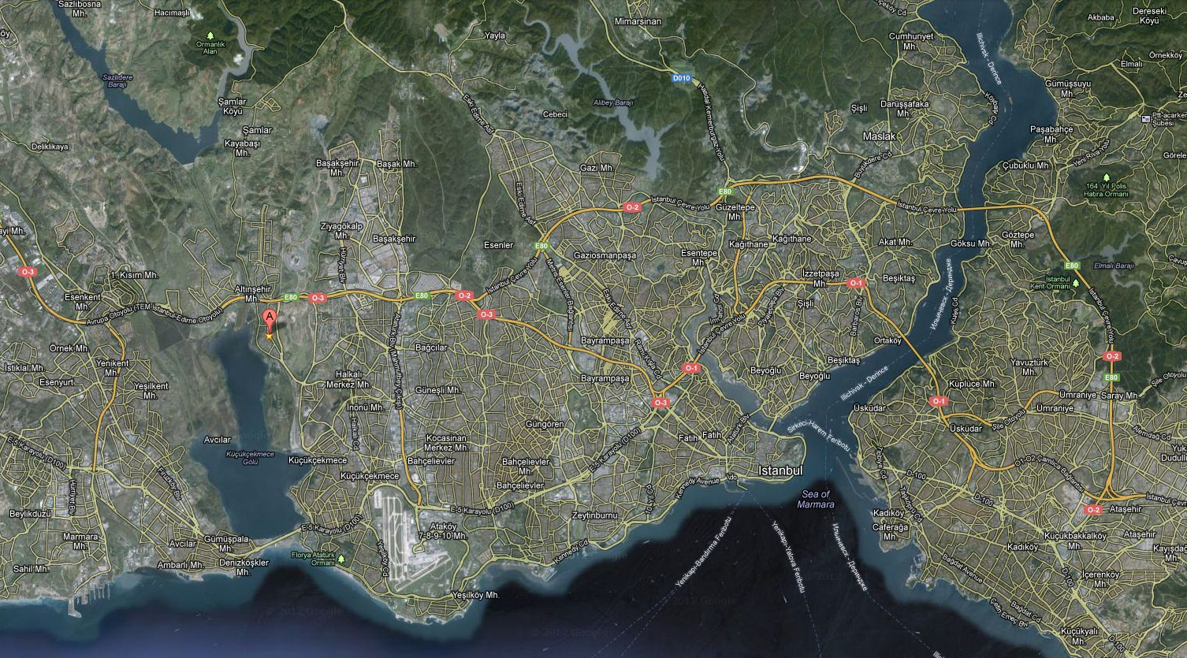
Notes:
Yarımburgaz Cave, very close to Istanbul City.

Slide 4
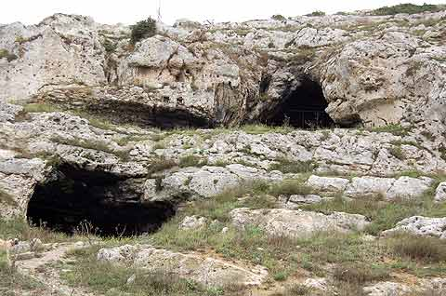
Notes:
This cave is special and important in so many respects

Slide 5
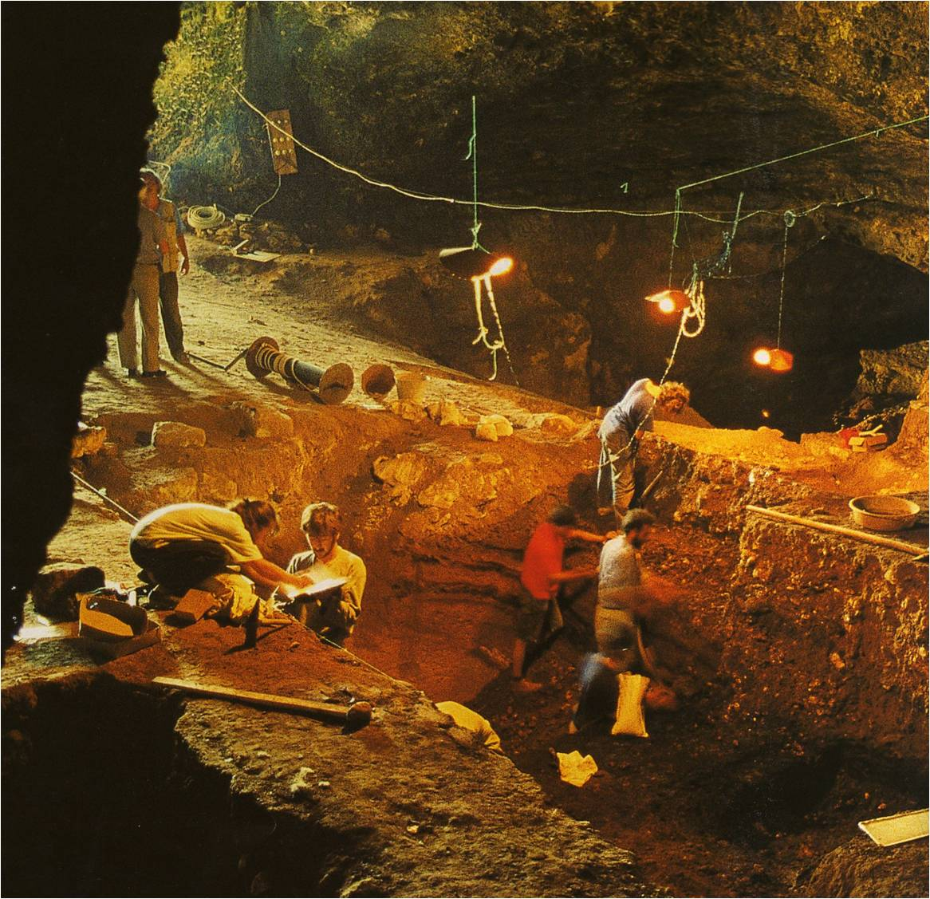
Notes:
Let me start with the fact that artifacts recovered in archeological digs in the cave were dated to 700,000 years ago

Slide 6
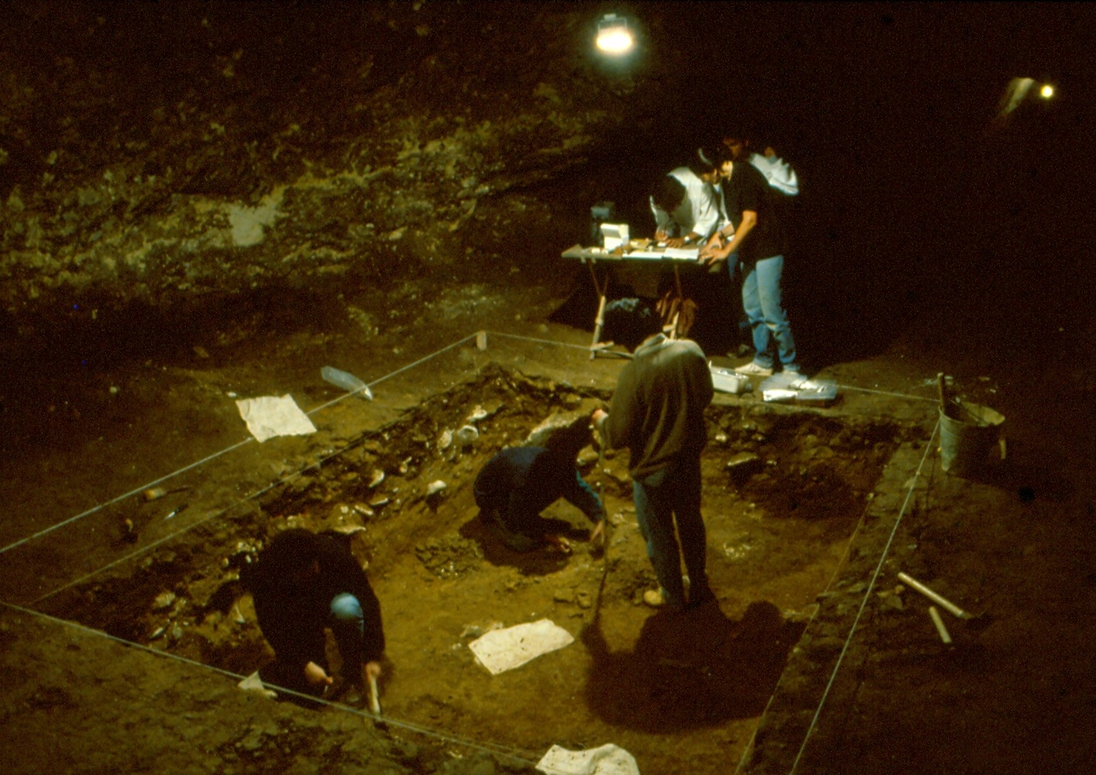
Notes:
And it is not only human remains. Prior to these excavations…

Slide 7
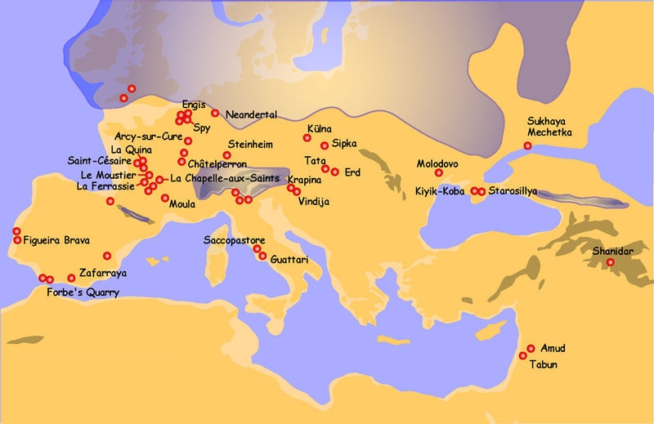
Notes:
Take a look at this map, which shows worldwide Neanderthal finds. You will notice that there is a huge gap between the Middle East finds

Slide 8
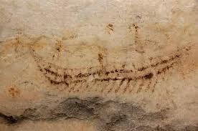
Notes:
We have little time, so I can skip many of the later gems, such as this beautiful wall drawing of a ship...

Slide 9
Notes:
So, going back to Yor, the hunter future the future...

Slide 10
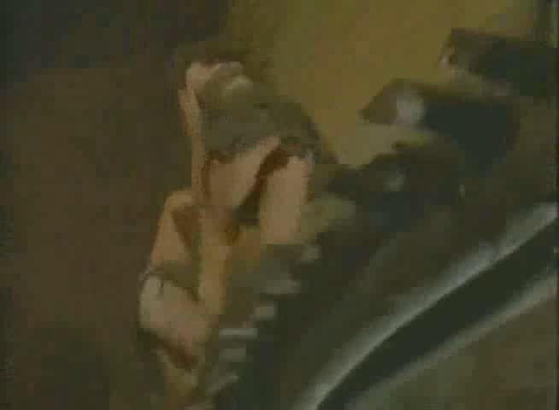
Notes:
You want to see the action? Here it is...

Slide 11
The 100 Most Enjoyably Bad Movies Ever Made
1983 Golden Raspberry Nominations:
Worst New Star
Worst Musical Score
Worst Original Song
Notes:
And - this is funny, yet not so funny - the film was listed in the

Slide 12
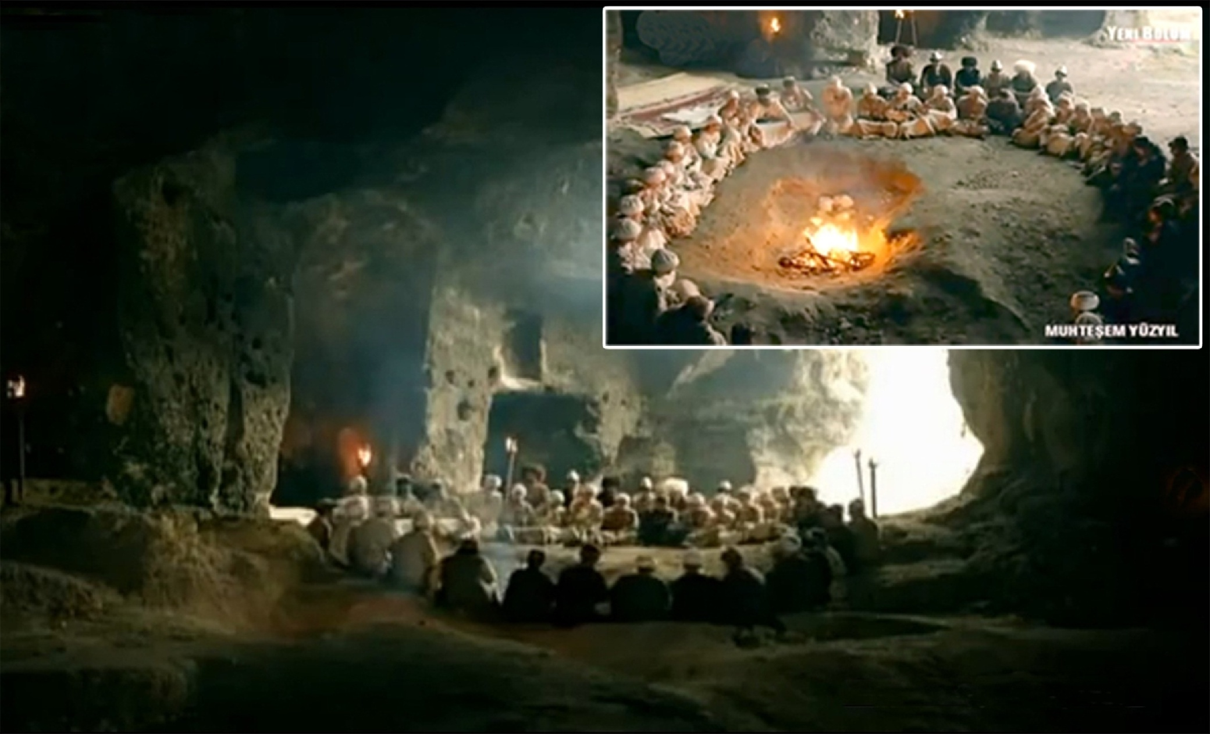
Notes:
OK, we started with an extreme example from a 1980's film

Slide 13
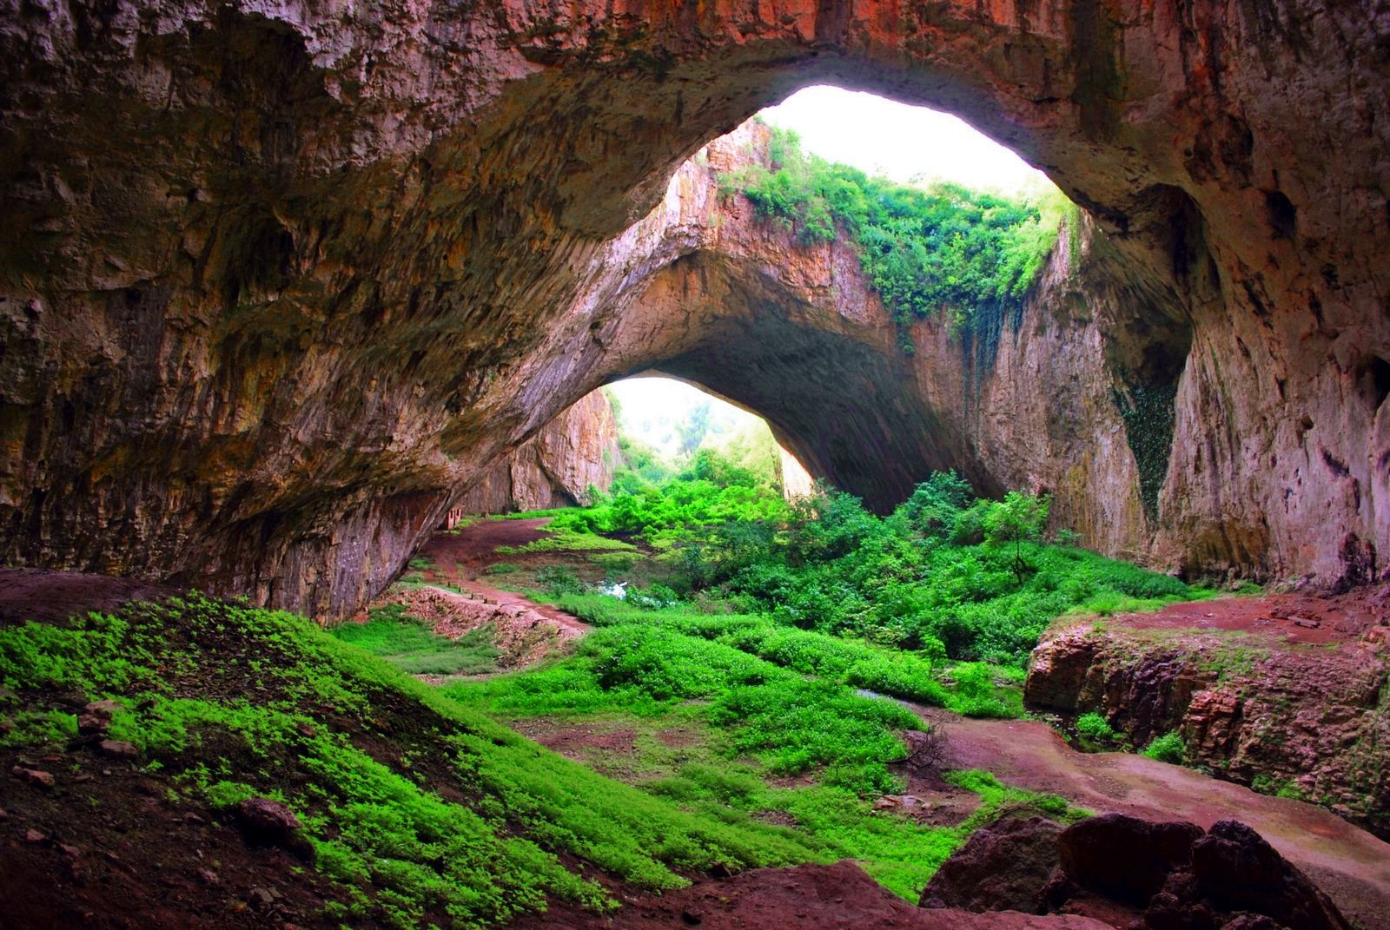
Notes:
Most of you must be aware of what happened last year in Devetashka cave in Bulgaria only last year.

Slide 14

Notes:
Scenes of the Hollywood block buster film Expendables II were shot in this magnificent cave

Slide 15
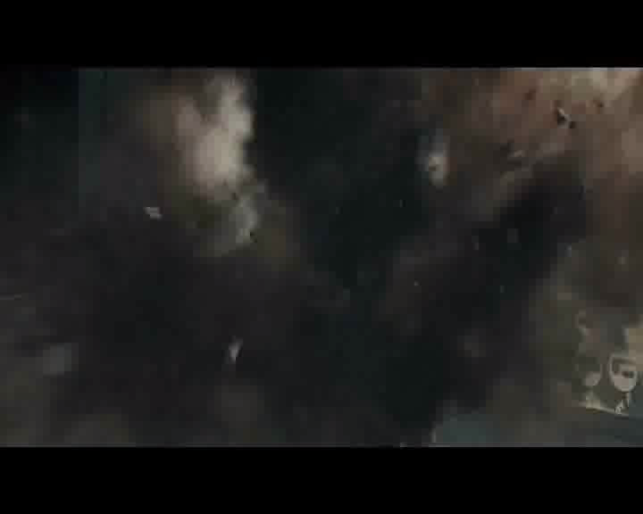

Slide 16
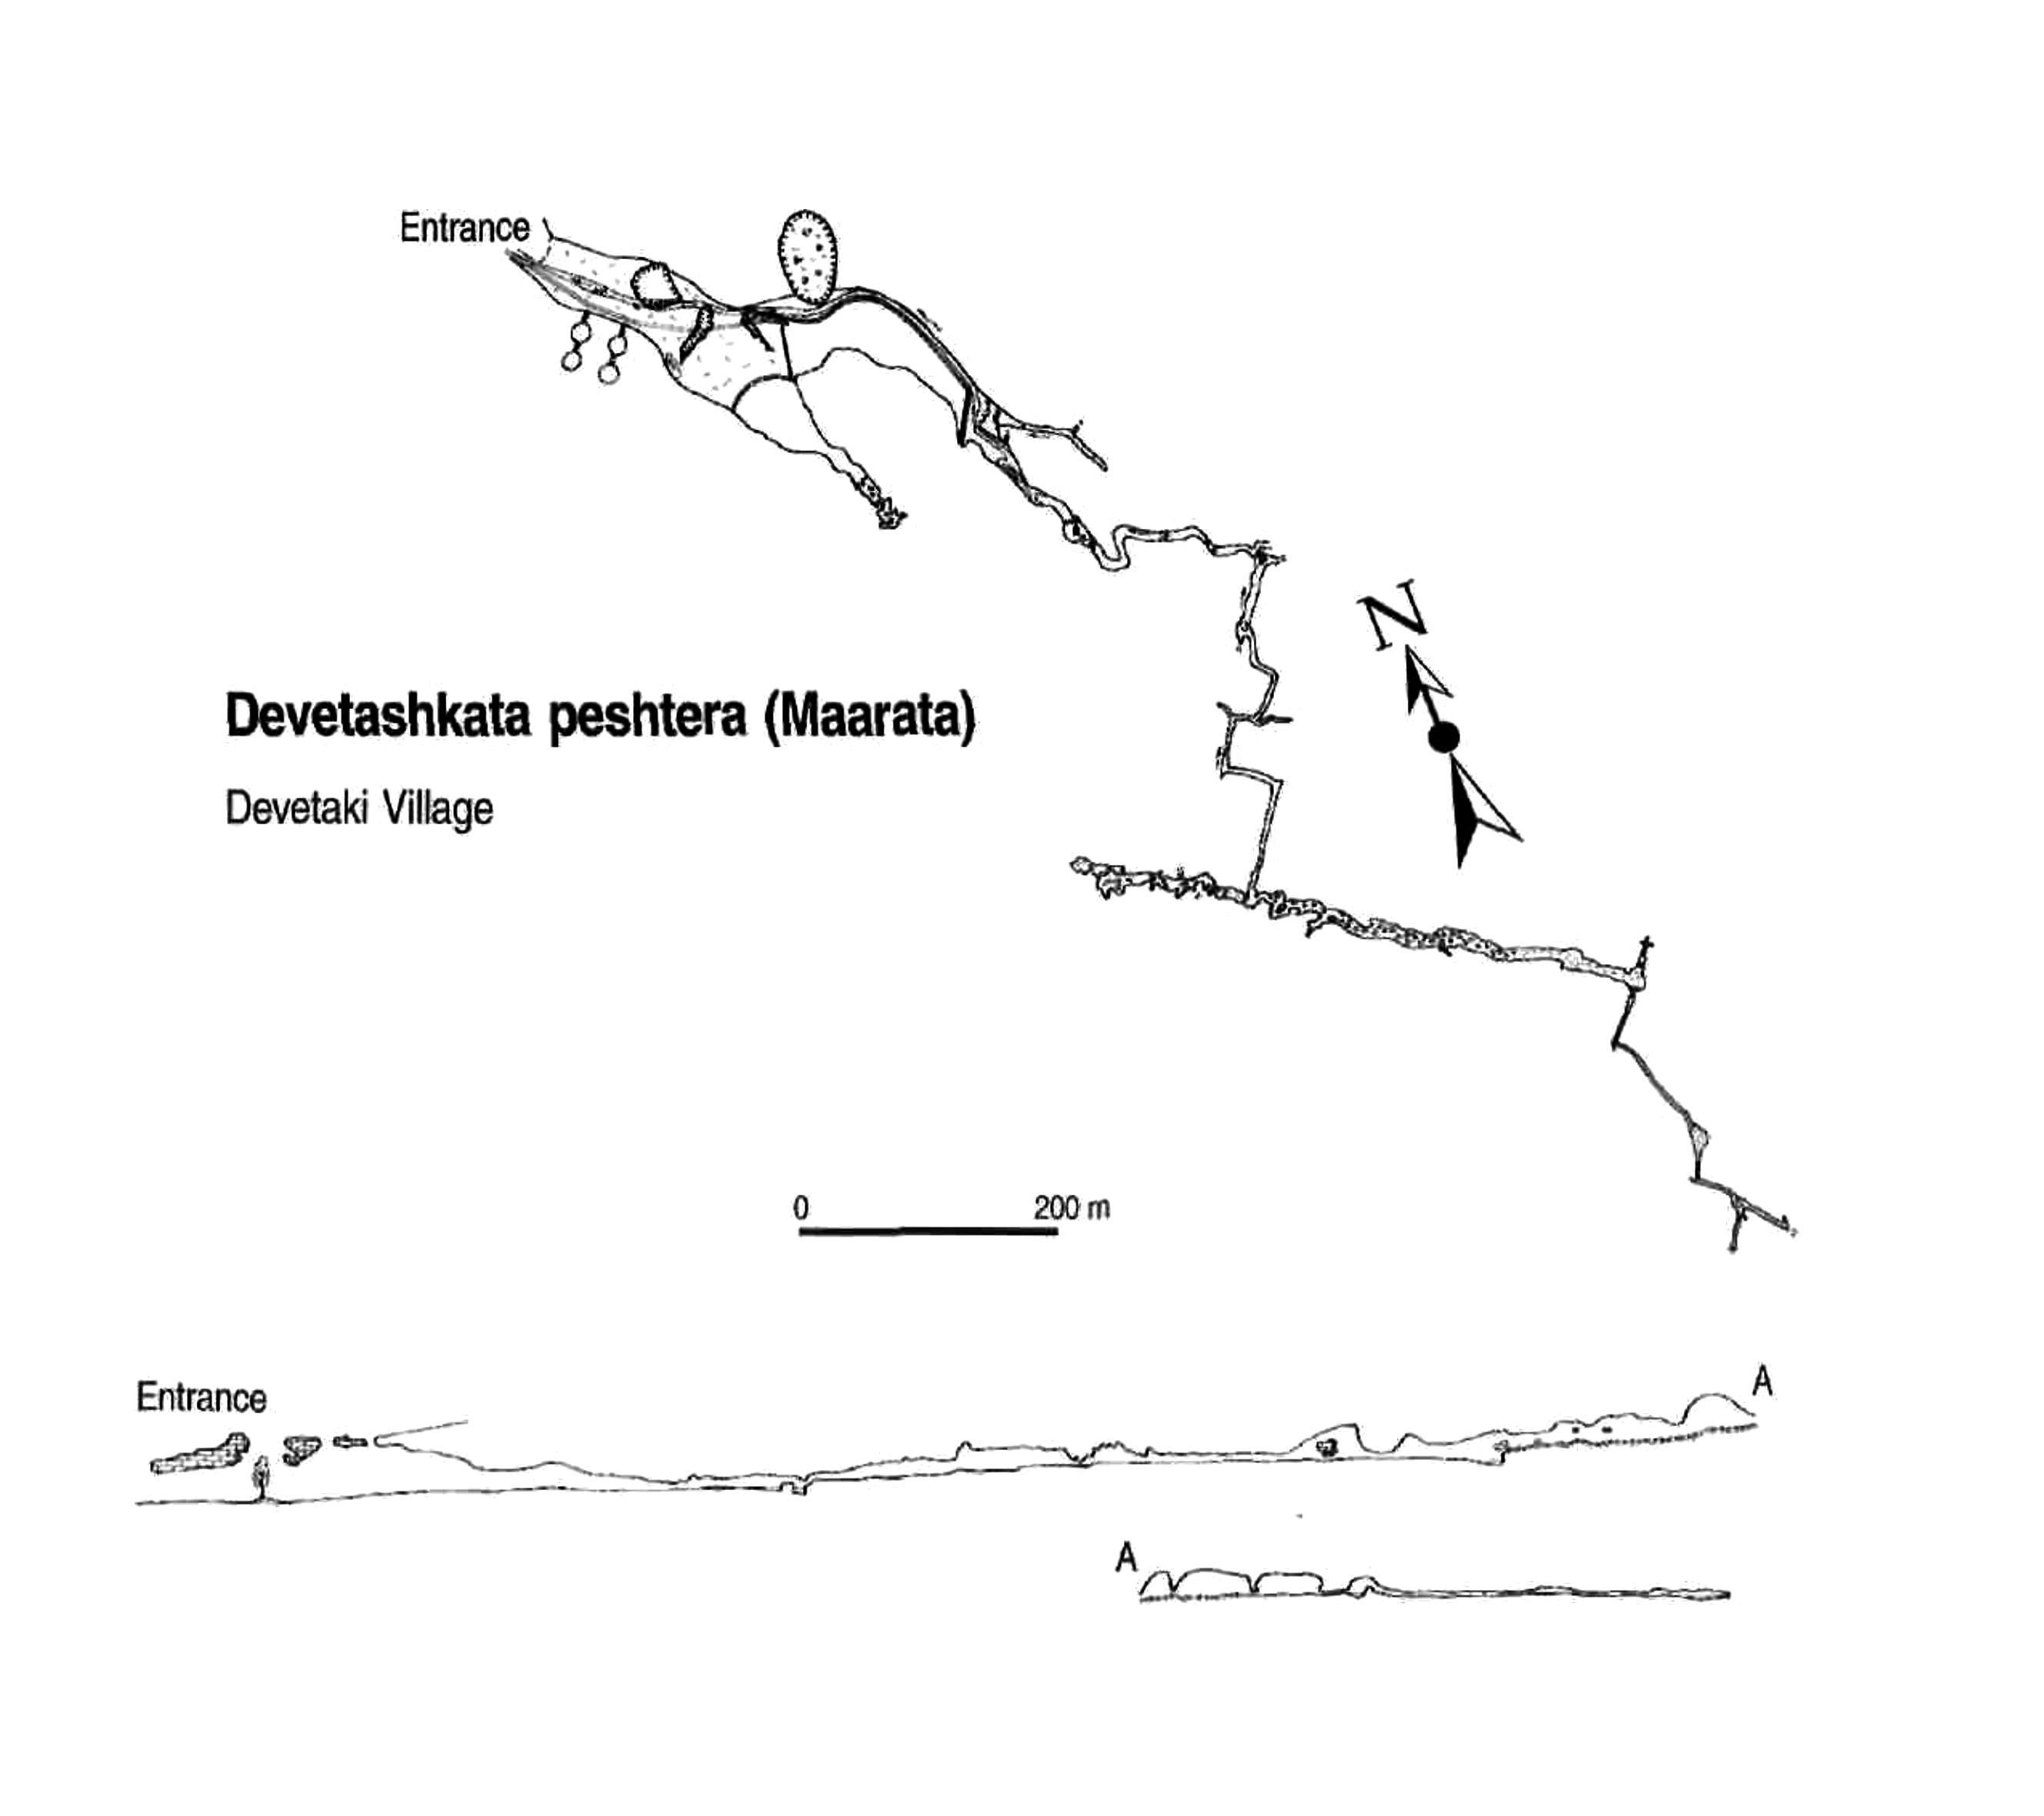
Notes:
It is one of the biggest caves in Bulgaria at almost 2.5 kilometers long,

Slide 17
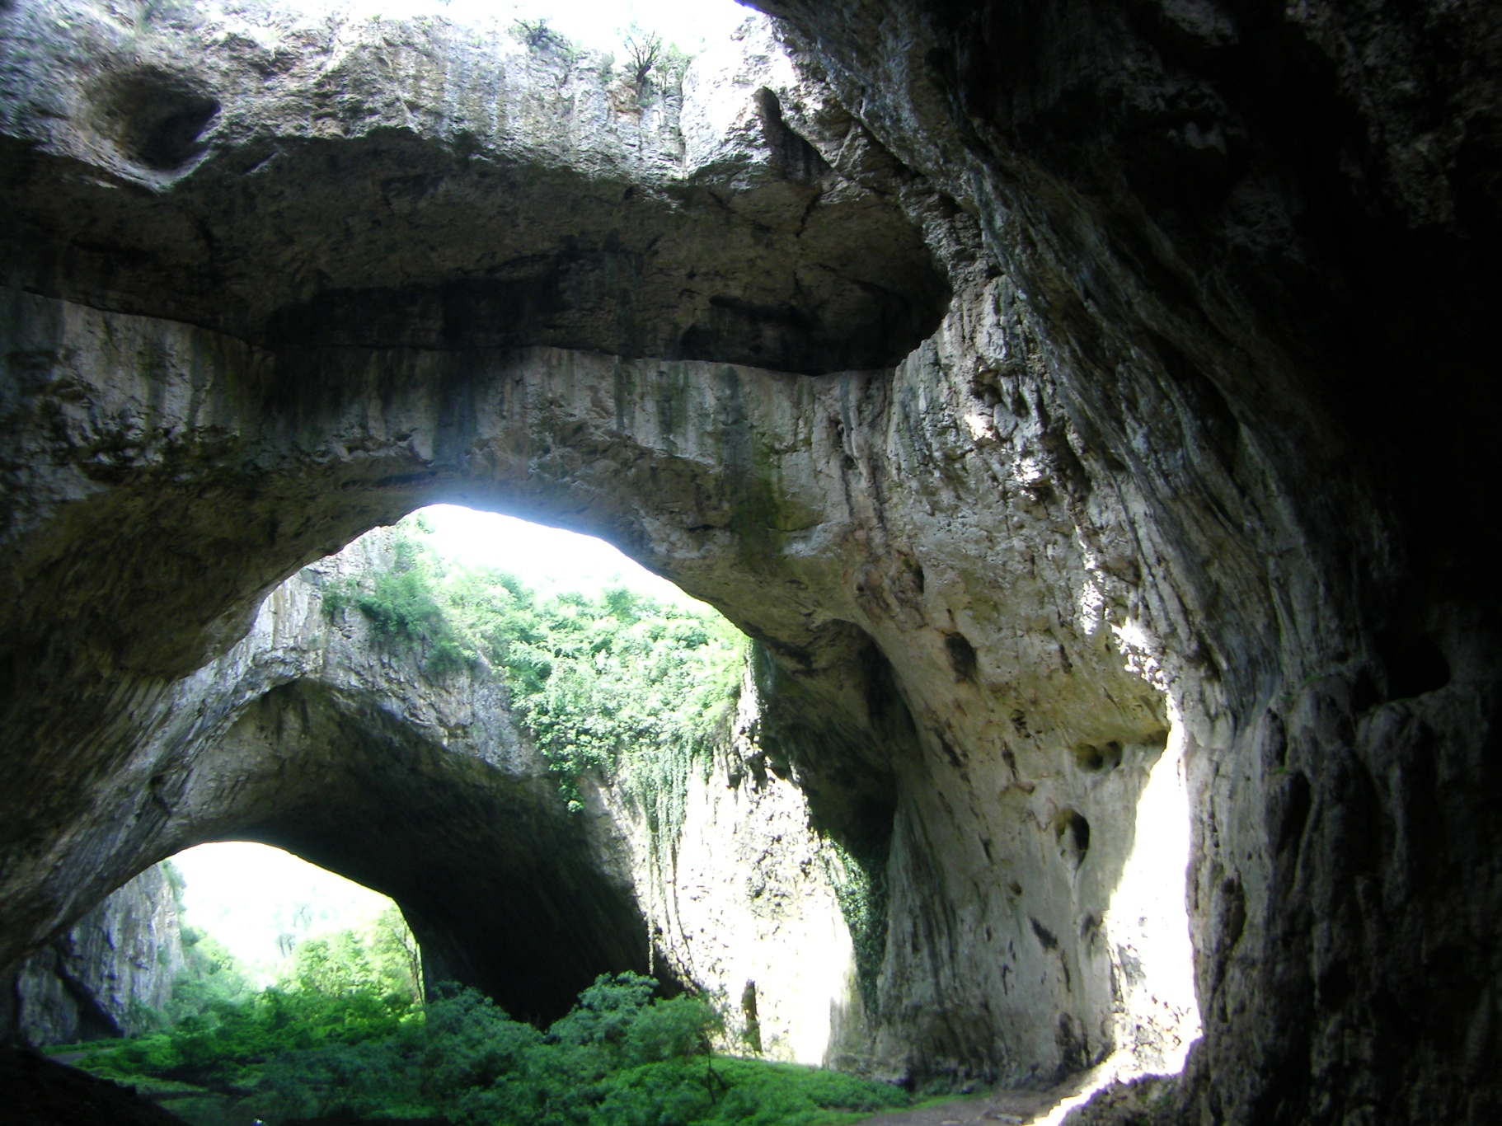
Notes:
Under current Bulgarian legislation Devetashka cave is restricted to tourism and scientific research.

Slide 18
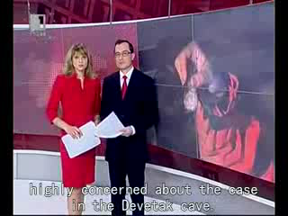
Notes:
The Bulgarian cavers have done their part in trying to prevent it, but ...

Slide 19
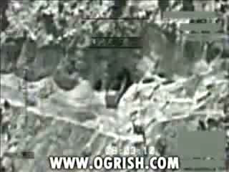
Notes:
let's take a brief look at one of the most destructive human occupations: War

Slide 20
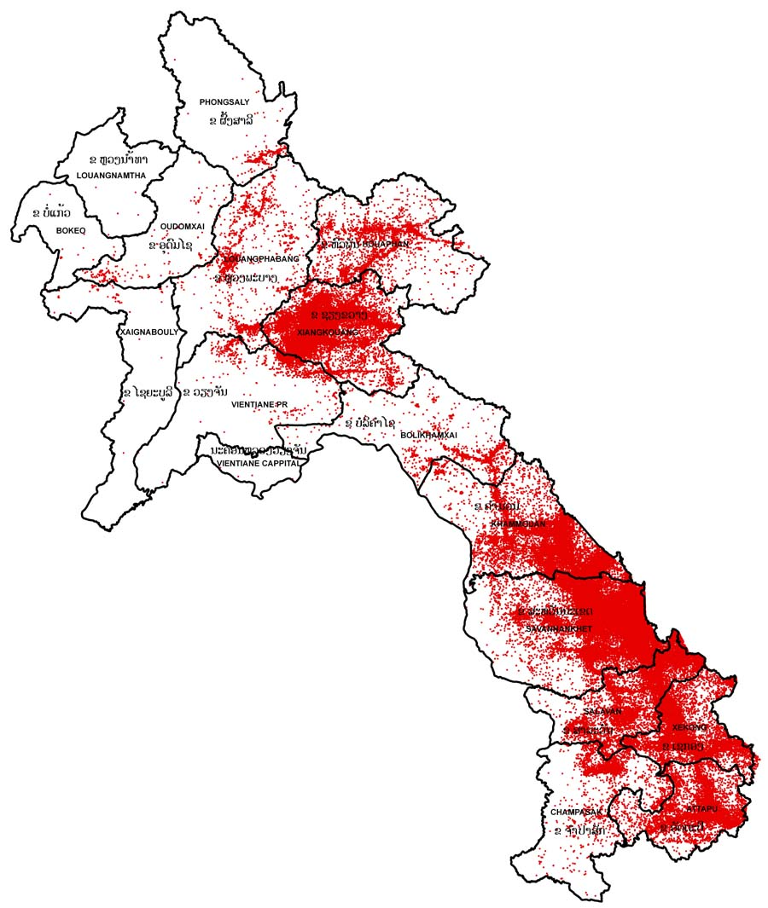
Notes:
Laos suffered about 50 years ago. Between 1964 and 73, US aerial bombardment hit this small country

Slide 21
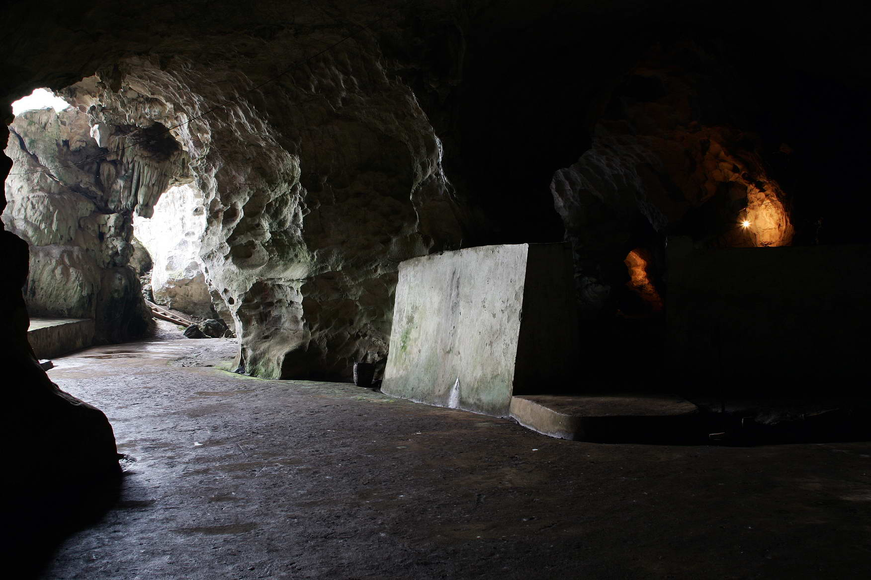
Notes:
Viengxay caves in North-Eastern Laos

Slide 22
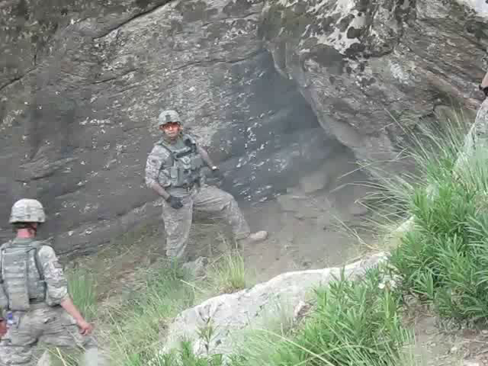
Notes:
Imagine yourself 20 years from now, exploring this cave

Slide 23
Botmeh Cave
Notes:
consider the “discovery” of Botmeh Cave by Speleo Club du Liban, near Beirut. Imagine this: you have found a previously unsurveyed cave,

Slide 24
Botmeh Cave
Notes:
You are not going to put your feet on that floor, no you are not.

Slide 25
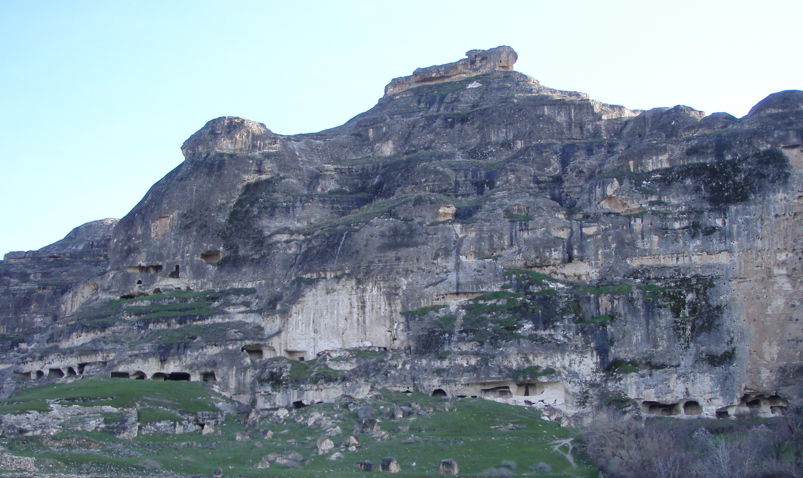
Notes:
For example, this cave was submerged before even a single sole had a chance to investigate it

Slide 26
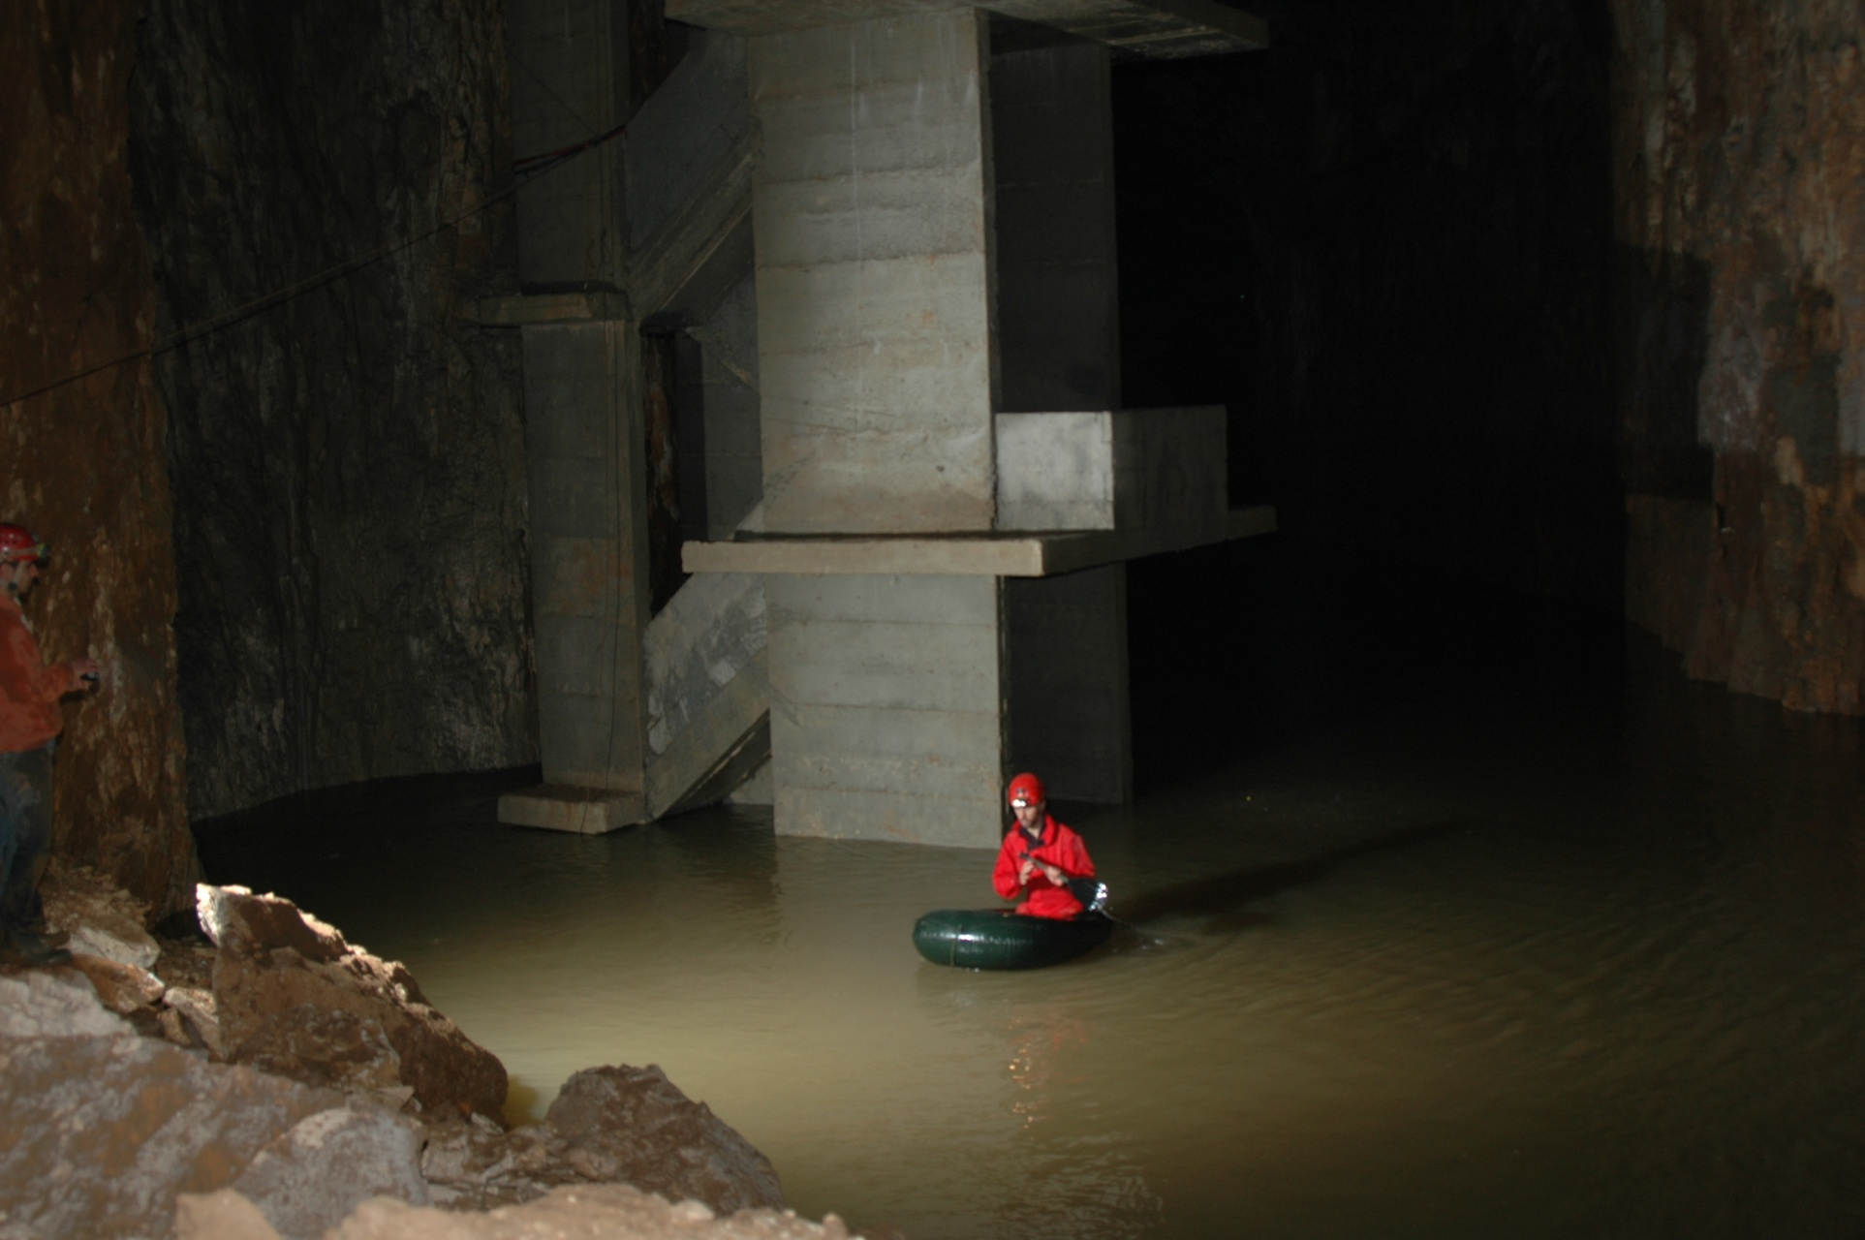
Notes:
Consider the Antelias Cave in Lebanon. It wasn't submerged behind a dam, it became the dam itself.

Slide 27
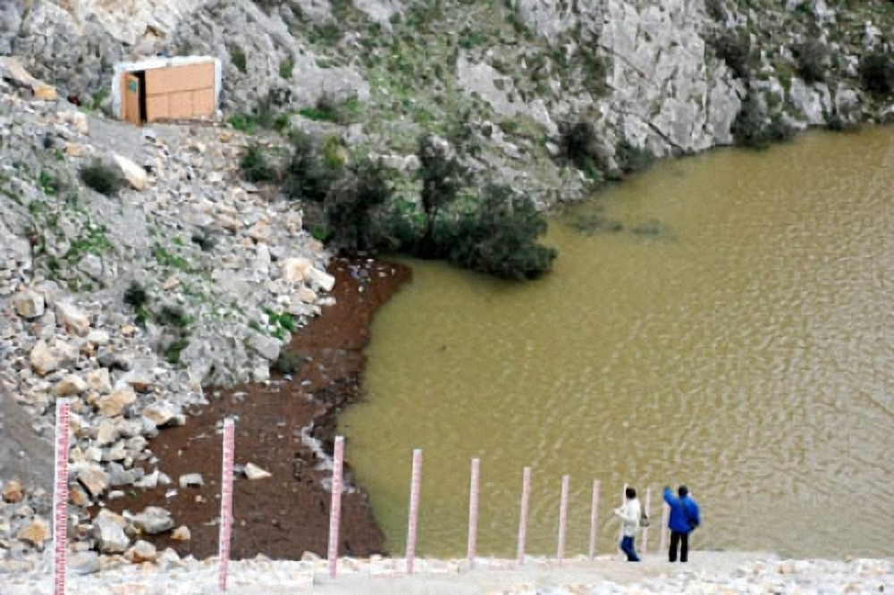
Notes:
Another tragic story comes from Turkey.

Slide 28
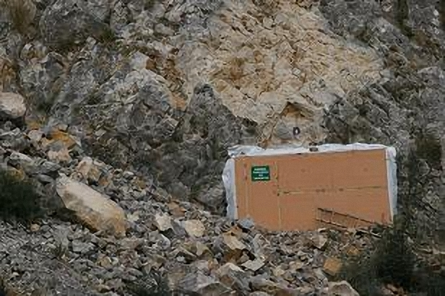
Notes:
Except that there was a small problem. The 30,000 strong colony refused to cooperate.

Slide 29
Notes:
Maybe we didn't have a chance to stop the destruction in Yarimburgaz Cave 30 years ago

Slide 30
Notes:
We *should* have been able to stop filming in the Devetaska Cave.

Slide 31
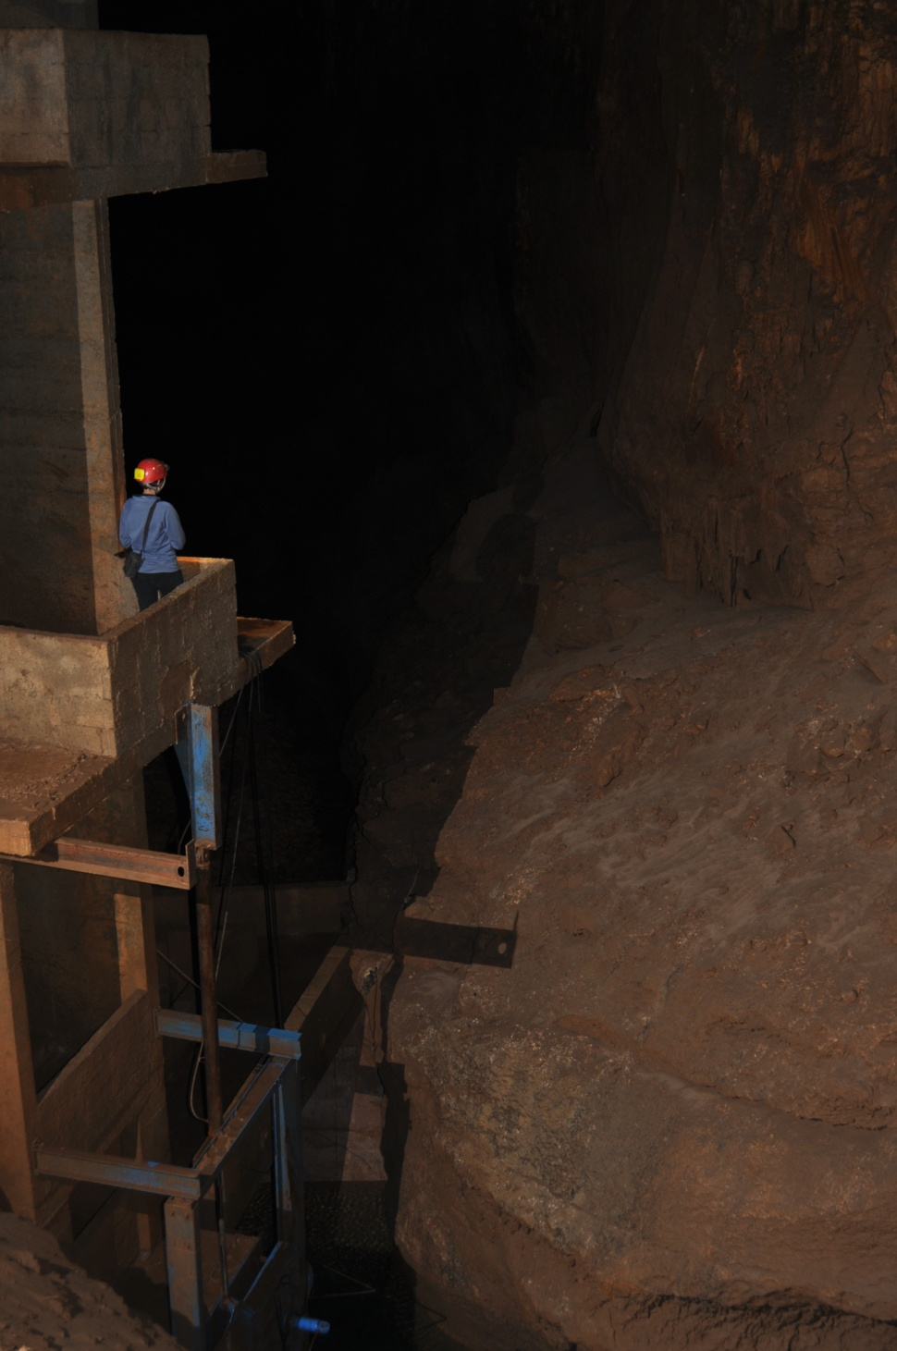
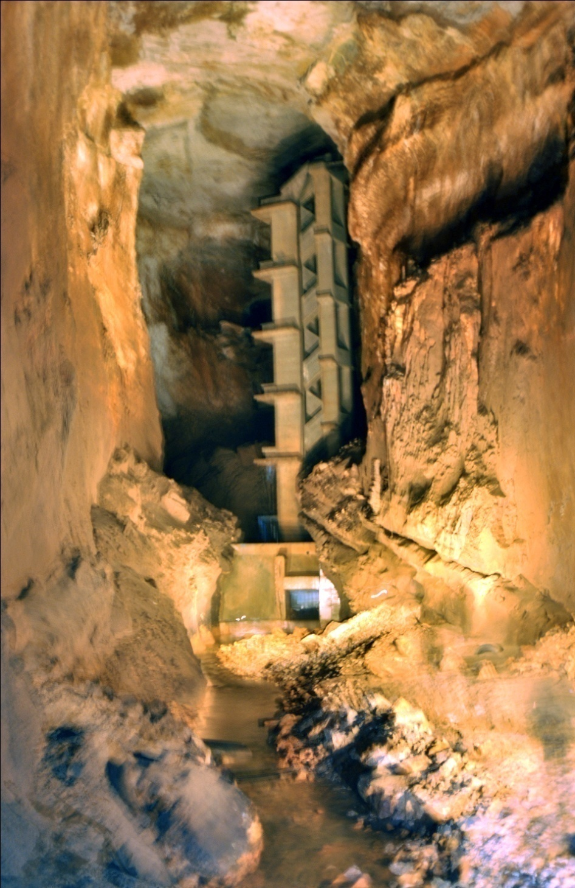
Notes:
We *should* be able to stop a dam being built our of concrete right inside a cave in Lebanon;

Slide 32
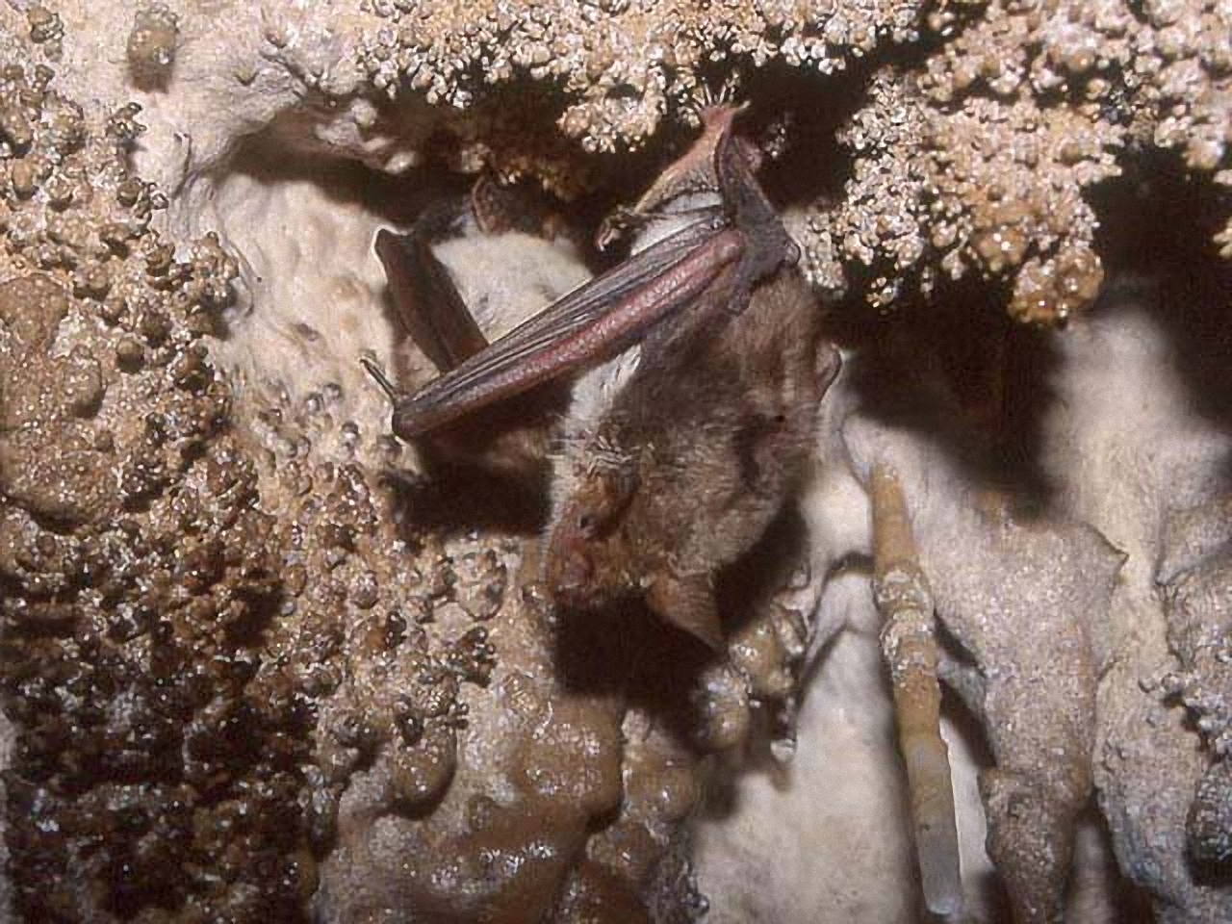
Notes:
We *should* be able to expose a comical attempt at bat relocation and save endangered species

Slide 33
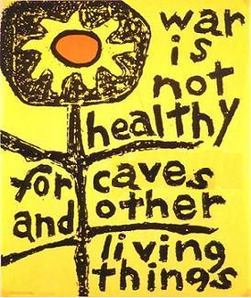
Notes:
Thank you

